Slide 1
COMP6348001 Network Forensics
Introduction to Network Forensics Course
Session 1
Ardimas Andi Purwita
ardimas.purwita@binus.edu

Slide 2
Main Goal
To give you an idea what we will do for the rest of the semester

Slide 3
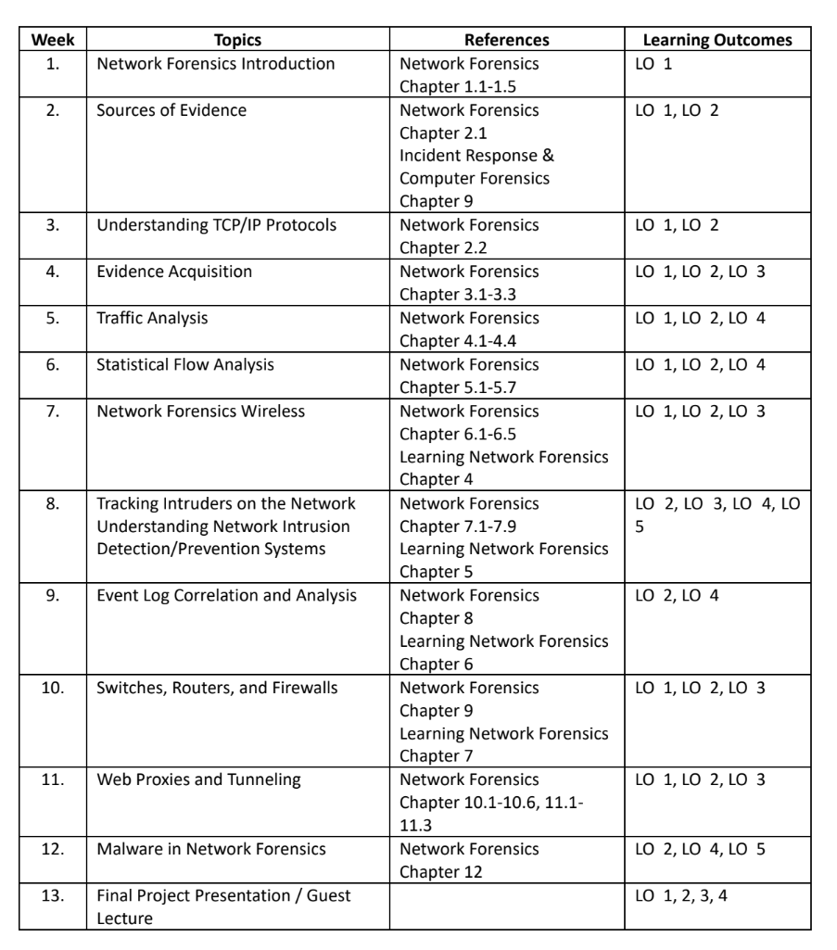
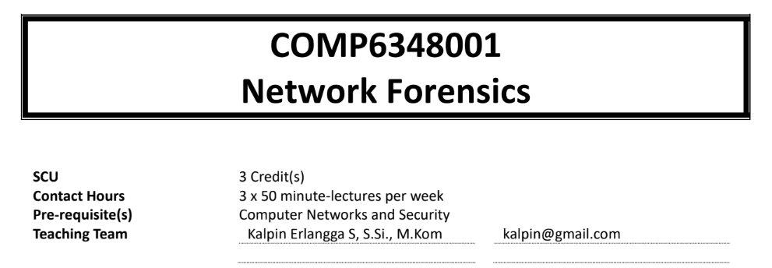
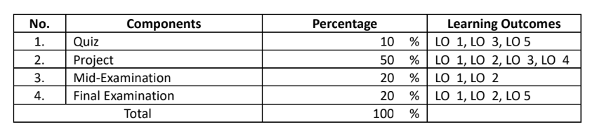
You’re gonna play detective!! :D

Slide 4
Network Forensics Methodology: OSCAR
Obtain information
Strategize
Collect evidence
Analyze
Report

Slide 5
Obtain Information
As a forensic investigator, you will collect both the information and the environment about the incident
Information:
description (e.g., date, timestamp, incident discovery, persons involved, etc),
actions taken since discovery,
legal issues,
structure organization,
internal network topology,
objectives,

Slide 6
Strategize
Important issue → data can be volatile!
Strategy to acquire evidence
Strategy what type of evidence that will be acquired
Estimate the resources and the cost for the investigation

Slide 7
Collect Evidence
What is evidence in network forensics? TBA in the next session
But, during the investigation, all activities need to be logged
Why? Because everything will be presented in the court
Therefore, during the evidence acquisition or during the investigation, as a forensic investigator we need to be mindful that we don’t change the state of evidence

Slide 8
Analyze
Find out the chronological order of an incidence
To do that, we need to be able to:
find places to look into,
correlate information that have been gathered,
Eventually answer the who, the what, the how, the where, and the why (depending on the original objective of the investigation)
Beware of many false positives

Slide 9
Reporting
Convey the information
The report might need to be presented during a court activity
Therefore, the language in the report must be able to be understood by non-technical persons

Slide 10
What you need to prepare for our future activities?
…

Slide 11


